Slide 1
Relational Database Management System 116U01C403
Module 1
Jan 2024-May 2024

Slide 2
Introduction (5)
Introduction
Characteristics of databases
Comparison of File system and Database approach
Users of Database system
Concerns when using an enterprise database
Data Independence
DBMS system architecture
Database Administrator

Slide 3
Introduction
What is data, database, DBMS:
Data: Known facts that can be recorded and have an implicit meaning; raw
Database: a highly organized, interrelated, and structured set of data about a particular enterprise
Controlled by a database management system (DBMS)
DBMS
Set of programs to access the data
An environment that is both convenient and efficient to use
Database systems : used to manage collections of data that are
Highly valuable
Relatively large
Accessed by multiple users and applications, often at the same time.
A modern database system: a complex software system whose task is to manage a large, complex collection of data.

Slide 4
Types of Databases and Database Applications
Traditional applications:
Numeric and textual databases
More recent applications:
Multimedia databases
Geographic Information Systems (GIS)
Biological and genome databases
Data warehouses
Mobile databases
Real-time and active databases

Slide 5
Importance of “big data”
Government
Private Sector
Walmart handles more than 1 million customer transactions every hour, which is imported into databases estimated to contain more than 2.5 petabytes of data
Facebook handles 40 billion photos from its user base
Falcon Credit Card Fraud Detection System protects 2.1 billion active accounts world-wide
Science
Large Synoptic Survey Telescope will generate 140 Terabyte of data every 5 days
Biomedical computation like decoding human Genome and personalized medicine

Slide 6
Lifecycle of Data: 4 “A”s
2. Aggregation
Scattered data
Integrated data
1. Acquisition
3. Analysis
Log data
Knowledge
4. Application

Slide 7
Basic Definitions
Database:
A collection of related data.
Data:
Known facts that can be recorded and have an implicit meaning.
Mini-world:
Some part of the real world about which data is stored in a database. For example, student grades and transcripts at a university.
Database Management System (DBMS):
A software package/system to facilitate the creation and maintenance of a computerized database.
Database system:
The DBMS software together with the data itself. Sometimes, the applications are also included.

Slide 8
File system
Large amount of data needed for storing and processing
Volatile nature of data : while the program is running the out put will be stored/ displayed
Sharing of information between various programs
Records/ structure/ union/ vectors
Sequential access/ Random access

Slide 9
Facilities provided by DBMS
Define a particular database in terms of its data types, structures, and constraints
Construct or load the initial database contents on a secondary storage medium
Manipulating the database:
Retrieval: Querying, generating reports
Modification: Insertions, deletions and updates to its content
Accessing the database through Web applications
Processing and sharing by a set of concurrent users and application programs – yet, keeping all data valid and consistent
Protection or security measures to prevent unauthorized access
“Active” processing to take internal actions on data
Presentation and visualization of data
Maintenance of the database and associated programs over the lifetime of the database application

Slide 10
Applications interact with a database by generating
Queries: that access different parts of data and formulate the result of a request
- Transactions: that may read some data and “update” certain values or generate new data and store that in the database

Slide 11
Characteristics of the Database Approach
Self-describing nature of a database system:
A DBMS catalog stores the description of a particular database (e.g. data structures, types, and constraints)
The description is called meta-data*.
This allows the DBMS software to work with different database applications.
Insulation between programs and data:
Called program-data independence.
Allows changing data structures and storage organization without having to change the DBMS access programs
E.g., ADTs

Slide 12
Characteristics of the Database Approach (..contd)
Data abstraction:
A data model is used to hide storage details and present the users with a conceptual view of the database.
Programs refer to the data model constructs rather than data storage details
Support of multiple views of the data:
Each user may see a different view of the database, which describes only the data of interest to that user.

Slide 13
Characteristics of the Database Approach (..contd)
Sharing of data and multi-user transaction processing:
Allowing a set of concurrent users to retrieve from and to update the database.
Concurrency control within the DBMS guarantees that each transaction is correctly executed or aborted
Recovery subsystem ensures each completed transaction has its effect permanently recorded in the database
OLTP (Online Transaction Processing) is a major part of database applications; allows hundreds of concurrent transactions to execute per second.

Slide 14
Database users
Users may be divided into
Those who actually use and control the database content, and those who design, develop and maintain database applications (called “Actors on the Scene”)
Those who design and develop the DBMS software and related tools, and the computer systems operators (called “Workers Behind the Scene”).

Slide 15
Database users: Actors on the scene
Database administrators
Responsible for authorizing access to the database, for coordinating and monitoring its use, acquiring software and hardware resources, controlling its use and monitoring efficiency of operations.
Database designers
Responsible to define the content, the structure, the constraints, and functions or transactions against the database. They must communicate with the end-users and understand their needs.

Slide 16
Database users: Actors on the scene
End-users: They use the data for queries, reports and some of them update the database content. End-users can be categorized into:
Casual: access database occasionally when needed
Naïve or parametric: they make up a large section of the end-user population.
They use previously well-defined functions in the form of “canned transactions” against the database.
Users of mobile apps mostly fall in this category
Bank-tellers or reservation clerks are parametric users who do this activity for an entire shift of operations.
Social media users post and read information from websites

Slide 17
Database users: Actors on the scene
Sophisticated:
These include business analysts, scientists, engineers, others thoroughly familiar with the system capabilities.
Many use tools in the form of software packages that work closely with the stored database.
Stand-alone:
Mostly maintain personal databases using ready-to-use packaged applications.
An example is the user of a tax program that creates its own internal database.
Another example is a user that maintains a database of personal photos and videos.

Slide 18
Database users: Actors on the scene
System analysts and application developers
System analysts: They understand the user requirements of naïve and sophisticated users and design applications including canned transactions to meet those requirements.
Application programmers: Implement the specifications developed by analysts and test and debug them before deployment.
Business analysts: There is an increasing need for such people who can analyze vast amounts of business data and real-time data (“Big Data”) for better decision making related to planning, advertising, marketing etc.

Slide 19
Database users: Actors behind the scene
System designers and implementors:
Design and implement DBMS packages in the form of modules and interfaces and test and debug them. The DBMS must interface with applications, language compilers, operating system components, etc.
Tool developers:
Design and implement software systems called tools for modeling and designing databases, performance monitoring, prototyping, test data generation, user interface creation, simulation etc. that facilitate building of applications and allow using database effectively.
Operators and maintenance personnel:
They manage the actual running and maintenance of the database system hardware and software environment.

Slide 20
Database users
Application Programmer: interact with system through DML calls
Sophisticated users: form requests in a database query language
Specialized users: write specialized database applications that do not fit into the traditional database processing framework
Naïve users: invoke one of the permanent application programs that have been written permanently

Slide 21
Database Administrator
Coordinates all activities related to database systems
Has good understanding of the enterprise’s information
Administrator's duties include:
Schema definition
Storage structure and access method definition
Schema and physical organization modification
Granting user authorities to access database
Specifying integrity constraints
Acting as liaison with users
Monitoring performance and responding to changes in requirements

Slide 22
Advantages of Using the Database Approach
Controlling redundancy in data storage and in development and maintenance efforts.
Sharing of data among multiple users.
Restricting unauthorized access to data. Only the DBA staff uses privileged commands and facilities.
Providing persistent storage for program Objects
E.g., Object-oriented DBMSs make program objects persistent
Providing storage structures (e.g. indexes) for efficient query
Providing optimization of queries for efficient processing
Providing backup and recovery services
Providing multiple interfaces to different classes of users
Representing complex relationships among data
Enforcing integrity constraints on the database
Drawing inferences and actions from the stored data using deductive and active rules and triggers

Slide 23
Advantages of Using the Database Approach
Potential for enforcing standards:
Standards refer to data item names, display formats, screens, report structures, meta-data (description of data), Web page layouts, etc.
Reduced application development time:
Incremental time to add each new application is reduced.
Flexibility to change data structures:
Database structure may evolve as new requirements are defined.
Availability of current information:
Extremely important for on-line transaction systems such as shopping, airline, hotel, car reservations.
Economies of scale:
Wasteful overlap of resources and personnel can be avoided by consolidating data and applications across departments.

Slide 24
Limitations of the Database Approach
Main inhibitors (costs) of using a DBMS:
High initial investment and possible need for additional hardware
Overhead for providing generality, security, concurrency control, recovery, and integrity functions
When a DBMS may be unnecessary:
If the database and applications are simple, well defined, and not expected to change
If access to data by multiple users is not required
When a DBMS may be infeasible
In embedded systems where a general-purpose DBMS may not fit in available storage
When no DBMS may suffice:
If there are stringent real-time requirements that may not be met because of DBMS overhead (e.g., telephone switching systems)
If the database system is not able to handle the complexity of data because of modeling limitations
If the database users need special operations not supported by the DBMS

Slide 25
Data Model
Data Model:
A set of concepts to describe the structure of a database, the operations for manipulating these structures, and certain constraints that the database should obey.
Data Model Structure and Constraints:
Constructs are used to define the database structure
Constructs typically include elements (and their data types) as well as groups of elements (e.g. entity, record, table), and relationships among such groups
Constraints specify some restrictions on valid data; these constraints must be enforced at all times
Data Model Operations:
These operations are used for specifying database retrievals and updates by referring to the constructs of the data model.
Operations on the data model may include basic model operations (e.g. generic insert, delete, update) and user-defined operations (e.g. compute_student_gpa, update_inventory)

Slide 26
Data Model Categories
Conceptual (high-level, semantic) data models:
Provide concepts that are close to the way many users perceive data.
(Also called entity-based or object-based data models.)
Physical (low-level, internal) data models:
Provide concepts that describe details of how data is stored in the computer. These are usually specified in an ad-hoc manner through DBMS design and administration manuals
Implementation (representational) data models:
Provide concepts that fall between the above two, used by many commercial DBMS implementations (e.g. relational data models used in many commercial systems).

Slide 27
Data Schemas and Database Instance
Database Schema:
The description of a database.
Includes descriptions of the database structure, data types, and the constraints on the database.
Schema Diagram:
An illustrative display of (most aspects of) a database schema.
Schema Construct:
A component of the schema or an object within the schema, e.g., STUDENT, COURSE.

Slide 28
Data Schemas and Database Instance
Database State / database instance (or occurrence or snapshot):
The actual data stored in a database at a particular moment in time. This includes the collection of all the data in the database.
The term instance is also applied to individual database components, e.g. record instance, table instance, entity instance

Slide 29
Data Schemas and Database Instance
Database State / database instance (or occurrence or snapshot):
Database State:
Refers to the content of a database at a moment in time.
Initial Database State:
Refers to the database state when it is initially loaded into the system.
Valid State:
A state that satisfies the structure and constraints of the database.
Distinction
The database schema changes very infrequently.
The database state changes every time the database is updated.
Schema is also called intension.
State is also called extension.

Slide 30
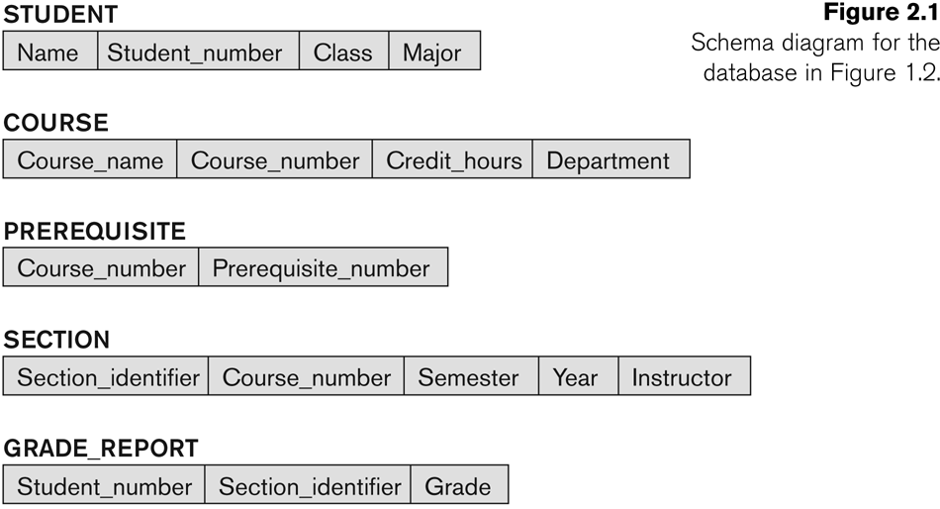
Data Schemas

Slide 31
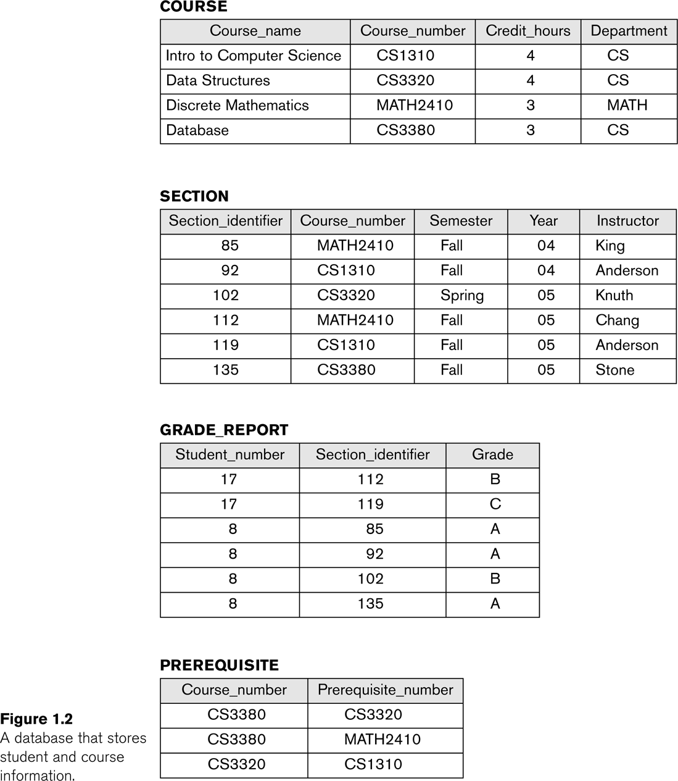
Database Instance

Slide 32
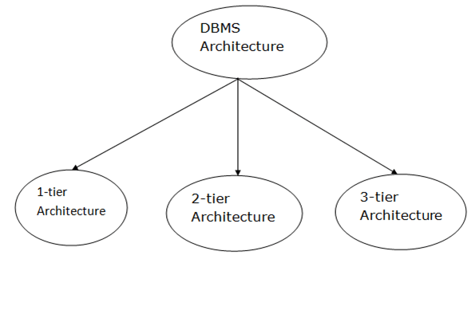
Types of DBMS Architecture

Slide 33
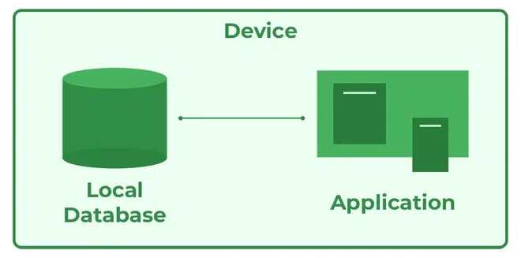
1-Tier Architecture
In this architecture, the database is directly available to the user. It means the user can directly sit on the DBMS and uses it.
Any changes done here will directly be done on the database itself. It doesn't provide a handy tool for end users.
The 1-Tier architecture is used for development of the local application, where programmers can directly communicate with the database for the quick response.

Slide 34
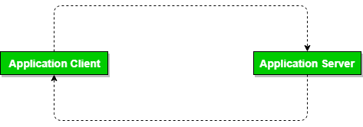
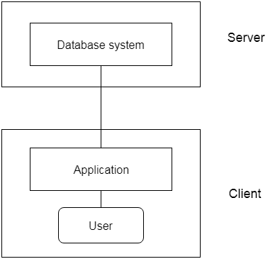
2-Tier Architecture
The 2-tier architecture is similar to a basic client-server model.
In the two-tier architecture, applications on the client end can directly communicate with the database at the server side. For this interaction, API's like: ODBC, JDBC are used.
The user interfaces and application programs are run on the client-side.
The server side is responsible to provide the functionalities like: query processing and transaction management.
To communicate with the DBMS, client-side application establishes a connection with the server side.

Slide 35
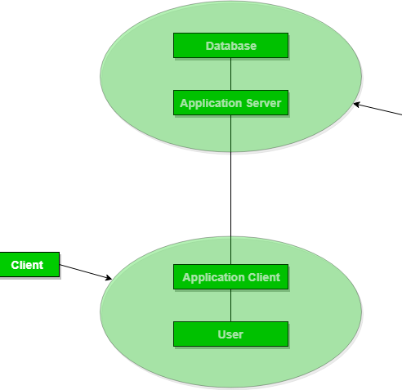
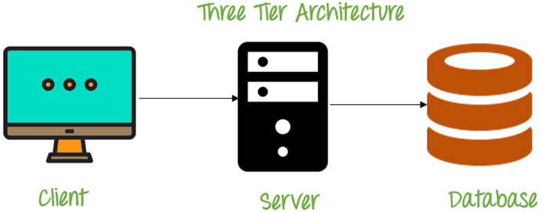
3-Tier Architecture
The 3-Tier architecture contains another layer between the client and server.
In this architecture, client can't directly communicate with the server.
The application on the client-end interacts with an application server which further communicates with the database system.
End user has no idea about the existence of the database beyond the application server. The database also has no idea about any other user beyond the application.
The 3-Tier architecture is used in case of large web application.

Slide 36
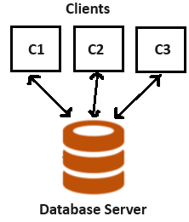
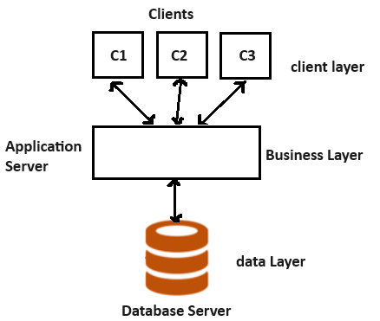
2-Tier
3-Tier

Slide 37
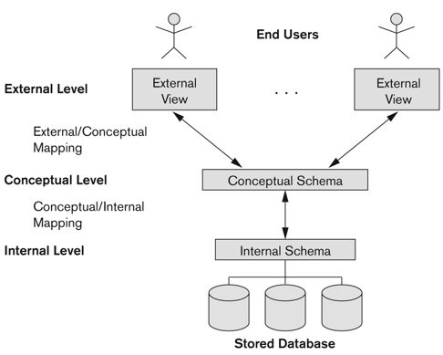
Three schema Architecture
Defines DBMS schemas at three levels:
Internal schema at the internal level to describe physical storage structures and access paths ( e.g. indexes).
Typically uses a physical data model.
Conceptual schema at the conceptual level to describe the structure and constraints for the whole database for a community of users.
Uses a conceptual or an implementation data model.
External schemas at the external level to describe the various user views.
Usually uses the same data model as the conceptual schema.

Slide 38
Three schema Architecture
Mapping is used to transform the request and response between various database levels of architecture.
Mapping is not good for small DBMS because it takes more time.
In External / Conceptual mapping, it is necessary to transform the request from external level to conceptual schema.
In Conceptual / Internal mapping, DBMS transform the request from the conceptual to internal level.

Slide 39
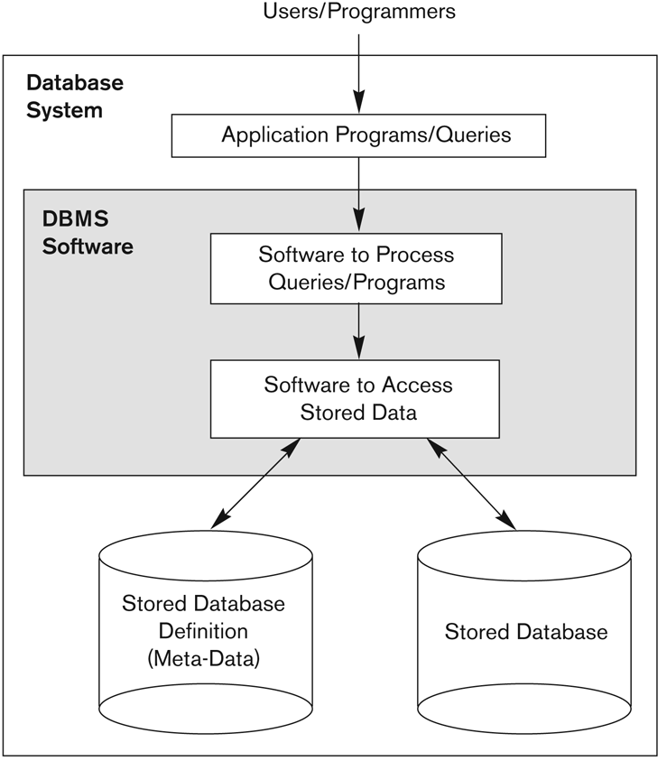
A simplified architecture of Database System

Slide 40
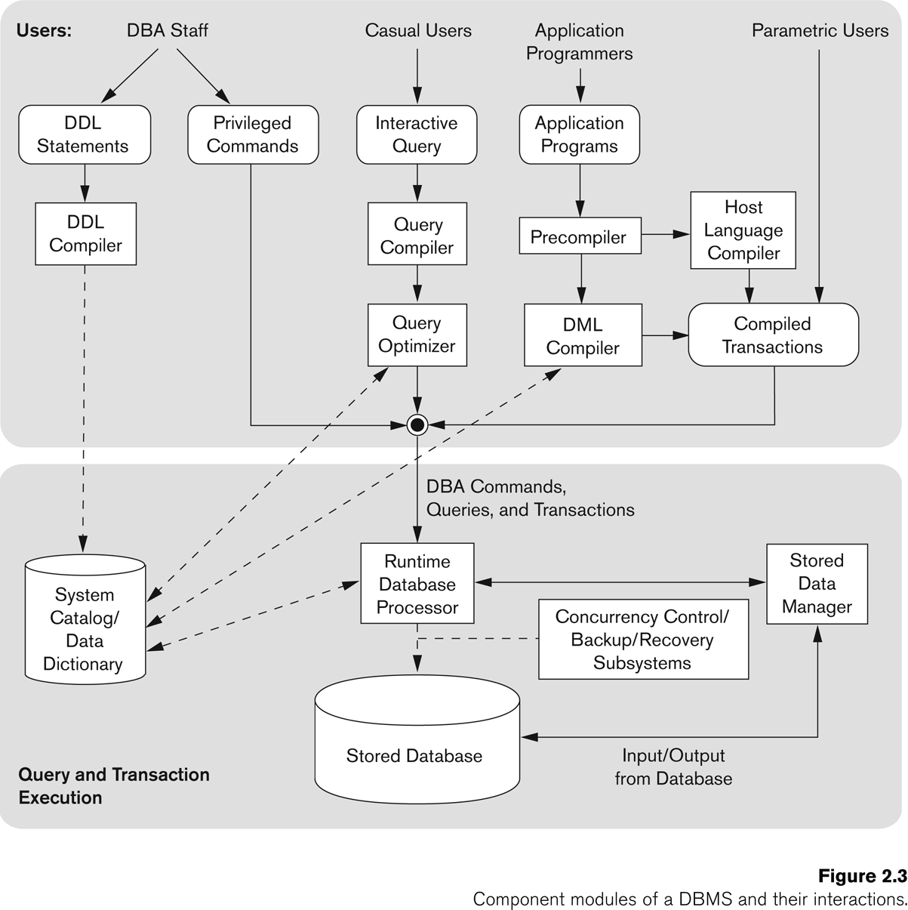
A simplified architecture of Database System

Slide 41
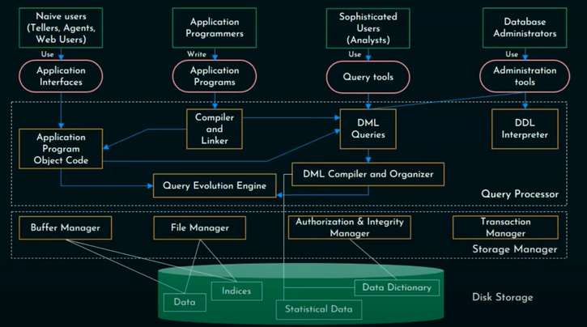
A simplified architecture of Database System

Slide 42
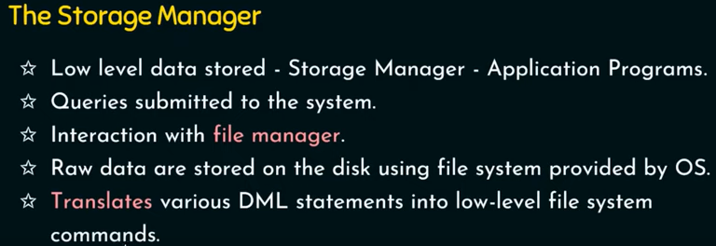
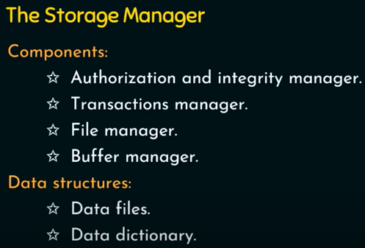
Buffer manager-cache the data on priority. Handle disk storage management
File manager- memory management and data structure allocation

Slide 43
